Slide 1
Sub4You
By: Rakshana Venkat & Akarsh Gupta

Slide 2
Agenda
Project Members
Project Abstract
User Stories & Design Diagrams
Major Project Constraints
Project Progress
Expected Accomplishments
Division of Work
Expected Demo at Expo

Slide 3
Project Members
Project Advisor: Dr. Will Hawkins
Rakshana Venkateswaran-
venkatrs@mail.uc.edu
+1 513 923 7119
Akarsh Gupta-
gupta3a6@mail.uc.edu
+1 513 837 6541

Slide 4
Project Abstract
Sub4You is a web-based sublease finder platform designed to simplify the housing search process for college students. The app connects students looking to sublease their apartments or rooms with verified renters through a user-friendly interface. It integrates features inspired by platforms like Airbnb—such as location-based listings, secure chat, and filters for budget, amenities, and lease duration—while incorporating smart recommendations to match users with ideal listings and roommates. Sub4You aims to make short-term housing more accessible, transparent, and efficient for the student community.

Slide 5
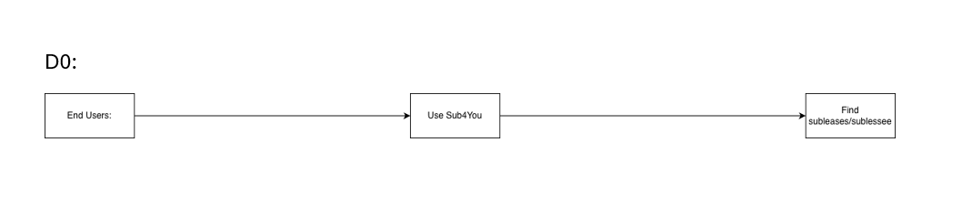
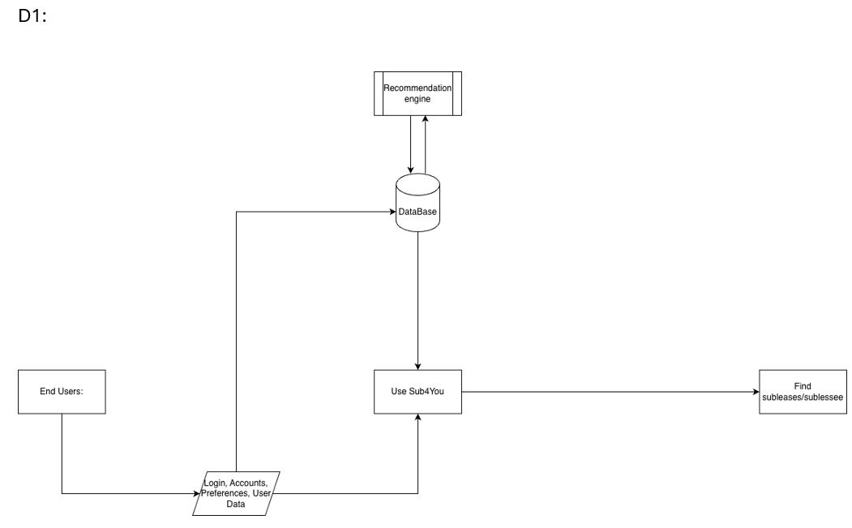
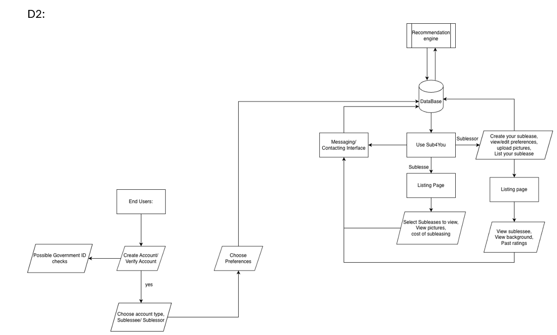
User Stories & Design Diagrams
As a sublease finder, I want to see top matches for my requirements, so that I can find a sublease
As a subleaser, I want to see top people for my room/house, so that I sublease my house

Slide 6
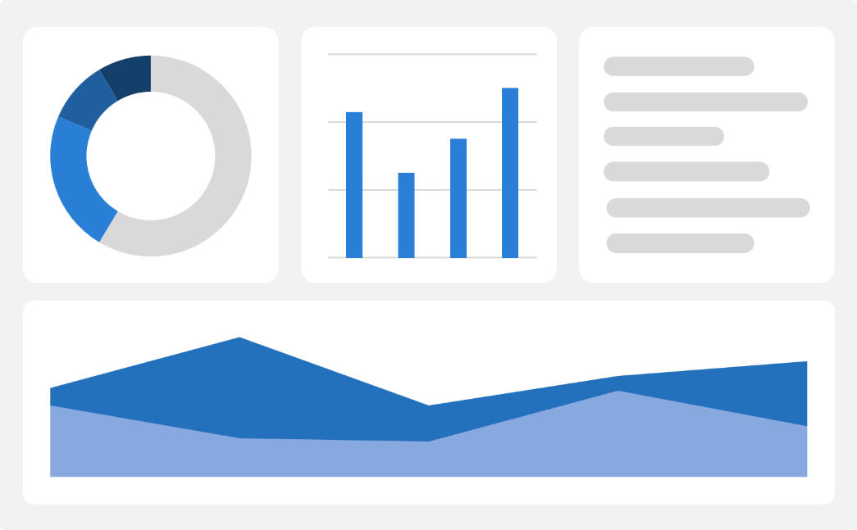
Major Project Constraints
Economic:
Limited budget; using free, open-source tools and student cloud credits.
Must balance features, performance, and cost.
Ethical:
Fair and transparent design with bias-free roommate matching.
Minimal data collection; users control what they share.
Legal:
Compliance with housing and privacy laws.
Verified listings only; copyright and data protection enforced..
Impact:
Constraints may limit early features but ensure a safer, more trustworthy app.

Slide 7
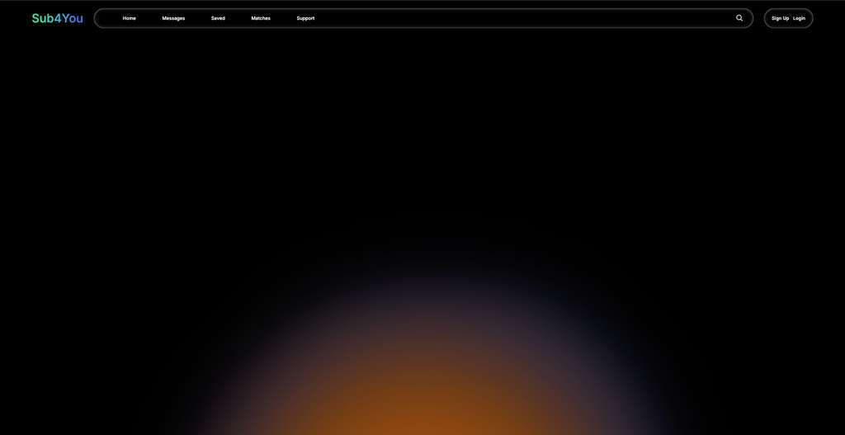
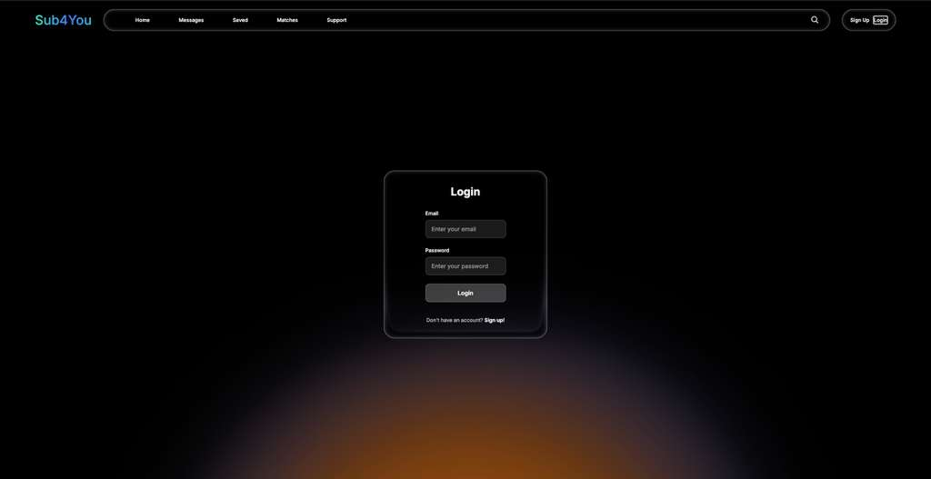
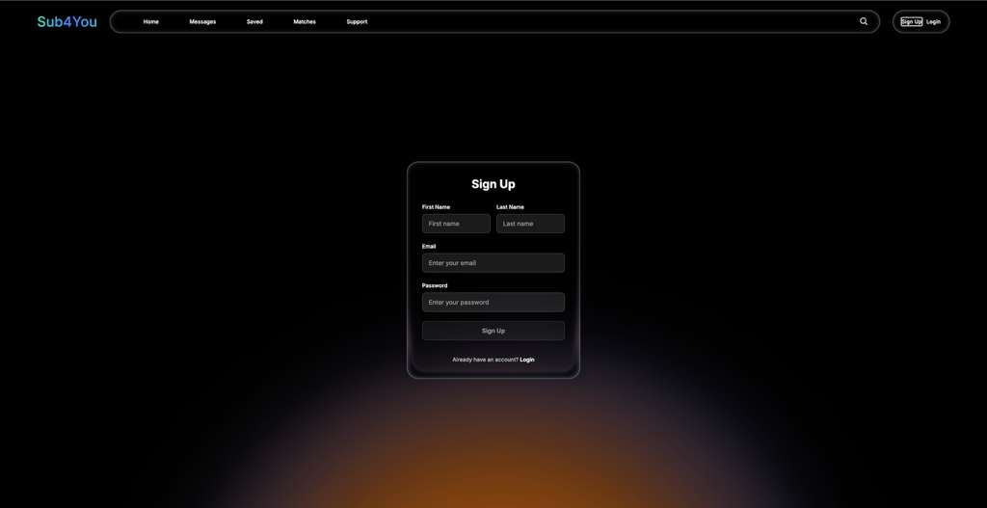
Project Progress
We decided to redesign our website from scratch after being inspired from our earlier design, we have gone for a more modern design with Liquid Glass design with a pulsating background.
We have finished working on the TopBar that stays as the navigation and the core for our project.
We have successfully set up our backend with Supabase. Therefore we have a functioning login/signup/logout and a user profile.

Slide 8
Expected Accomplishments
We expect to finish the Home page layout and populating that site with example data by Dec 20th.
We will be completing the Logo Design, upload, store and display of image working on our website by the end of Dec.
By Jan 15th we expect to finish designing the user profile for all user types, and implementing filtering with data.
By the end of Feb we expect to finish preferences based matching and all user interactions, including security features.
We want to finish the website by March with some polishing until April.
Jan 15th
Frontend designed, with some backend functionality
Feb 28th
Deeper backend functionality, secure user interactions.
April 15th
End product with full functionality and design.

Slide 9
Division of Work
Rakshana Venkateswaran-
Responsible for designing the frontend UI and overall app layout, ensuring the app is user-friendly and mobile-friendly.
Additionally, will manage data collection and preprocessing for listings, including cleaning and organizing data for training.
Also ensure smooth integration of the backend features with the frontend.
Akarsh Gupta-
Responsible for developing the smart matching, including training models, building recommendation algorithms, and ensuring accurate predictions.
Will also handle the backend systems, including APIs and database management.
And will work closely with the Frontend & Data Lead to integrate functionality seamlessly into the app.

Slide 10
Expected Demo at Expo
At the demo, we will showcase a fully functional website that highlights Sub4You’s core features. The demo will include user registration and login, browsing and posting sublease listings, and basic roommate matching. We’ll also demonstrate the secure backend integration with Supabase and the app’s clean, responsive front-end design.

Slide 11
Thank you!

